Slide 1

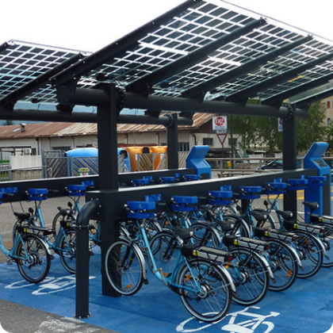
CYCLISTIC BIKE-SHARE • EXECUTIVE CASE STUDY
Converting Casual Riders to Annual Members
Q1 Behavioral Data Analysis & Growth Strategies for Executive Leadership
SE
Okunmuyide Semire Emmanuel
Lead Data Analyst • Power BI & Analytics

Slide 2
EXECUTIVE OVERVIEW
Q1 Performance & Rider Profile Snapshot
TOTAL Q1 TRIP VOLUME
ANNUAL MEMBER SHARE
CASUAL RIDER SHARE
791,956
91.0%
9.0%
Overall Dataset Analysis
720,313 Commuter Trips
71,643 Leisure Trips
Annual Member Behavior
Casual Rider Opportunity
Routine weekday commuters with predictable 13-minute transit times.
Weekend leisure cyclists riding 6x longer with high conversion potential.

Slide 3
TRIP DURATION DISPARITY
Casual Riders Stay on Docks 6x Longer
84.8 min
Average Casual Ride Duration vs. 13.2 min for Annual Members
Casual Rider
84.8 m
Annual Member
13.2 m

Slide 4
WEEKLY USAGE PATTERNS
Commuters Own Weekdays; Casuals Peak Weekends
Member Trips
Casual Trips
Weekday Commute Engine
Members average 110k–135k daily trips during work hours.
Weekend Surge Peak
Casual riders increase trip volume by over 200% on weekends.
Sun
Mon
Tue
Wed
Thu
Fri
Sat

Slide 5



STRATEGIC RECOMMENDATIONS
Three High-Impact Conversion Strategies
Targeted Weekend Campaigns
In-App Savings Calculator
Flexible Pass Credits
Focus digital promotions near parks and waterfront routes during weekend peak hours.
Trigger automated post-ride alerts highlighting exact cost savings under annual plans.
Credit weekend single-pass fees toward annual pass upgrades within 30 days.

Slide 6
EXECUTION ROADMAP
Four-Phase Implementation Strategy
1
2
3
4
Q1 Analytics Sign-Off
Q2 App Notification Build
Q3 Weekend Campaigns
Q4 Conversion Audit
Finalize Q1 baseline metrics and stakeholder agreement.
Deploy post-ride savings calculator alerts in mobile app.
Launch geo-targeted summer marketing at popular waterfront hubs.
Evaluate annual membership growth and revenue uplift.

Slide 7


EXPANSION HORIZONS
Expanding Scope for 12-Month Impact
1
Full 12-Month Seasonality Modeling
Incorporate summer and autumn peak datasets to refine annual projections.
2
Demographic & Route Analysis
Integrate start/end station GPS data to identify top conversion corridors.
3
Price Elasticity Testing
Test promotional membership discounts to find optimal price sensitivity.

Slide 8
CYCLISTIC BIKE-SHARE
Thank You & Strategic Q&A
Ready to execute data-driven campaigns to accelerate annual membership growth.

Slide 9


Image Sources
https://ecospazio.it/wp-content/uploads/2023/02/ecospazio_pensilina_modello_predazzo.jpg
Source: ecospazio.it
https://cdn.outsideonline.com/wp-content/uploads/2019/09/17/bike-boardwalk-city_s.jpg
Source: www.outsideonline.com

